Slide 1
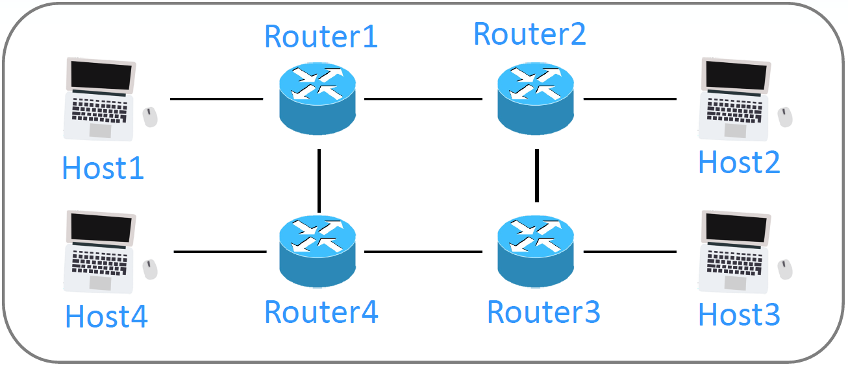
ASN 65000
ASN 65001
172.18.0.3
R1
R2
172.19.0.2
172.18.0.2
172.20.0.2
172.19.0.3
172.20.0.3
172.25.0.2
172.24.0.2
h1
h2
172.22.0.2
172.24.0.3
172.21.0.2
172.25.0.3
172.23.0.3
172.22.0.3
172.23.0.2
172.21.0.3
h4
R4
R3
h3
ASN 65003
ASN 65002

Slide 2
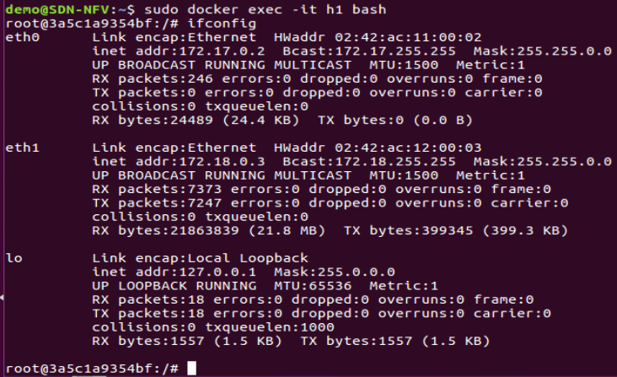
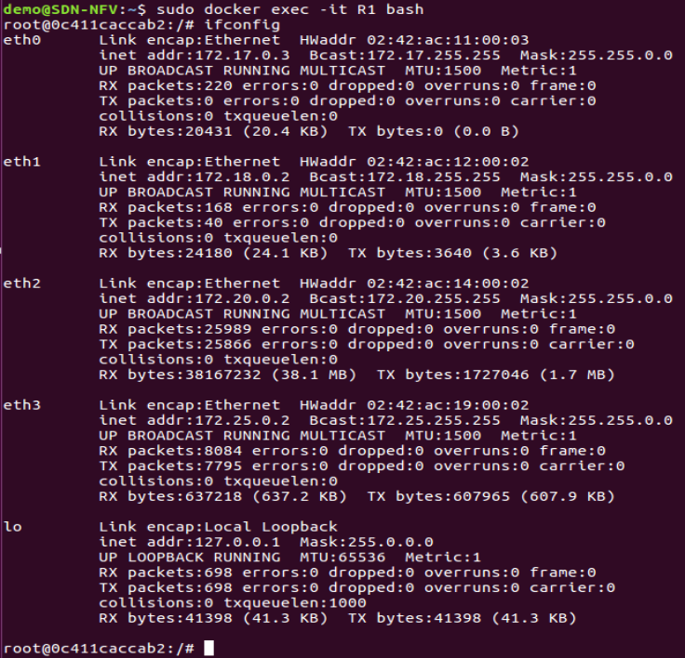

Slide 3
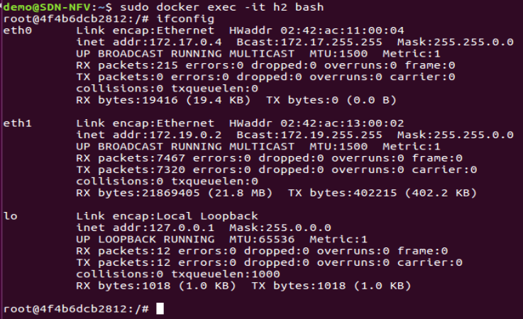
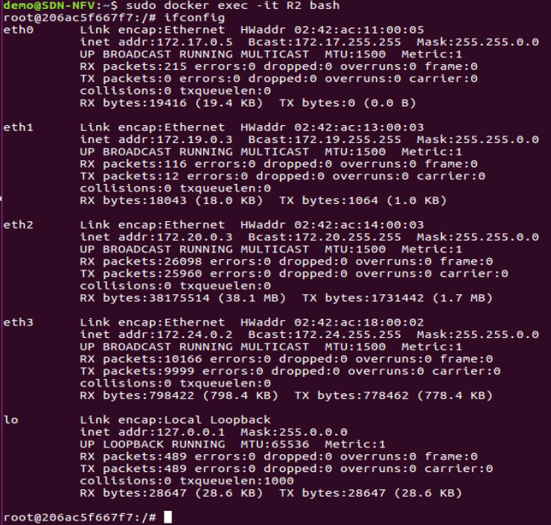

Slide 4
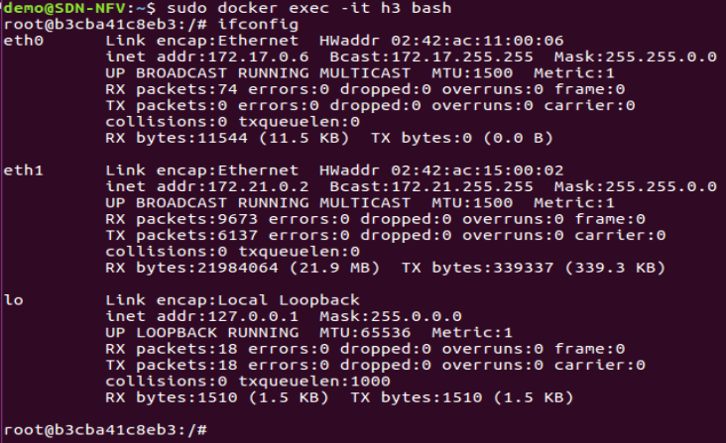
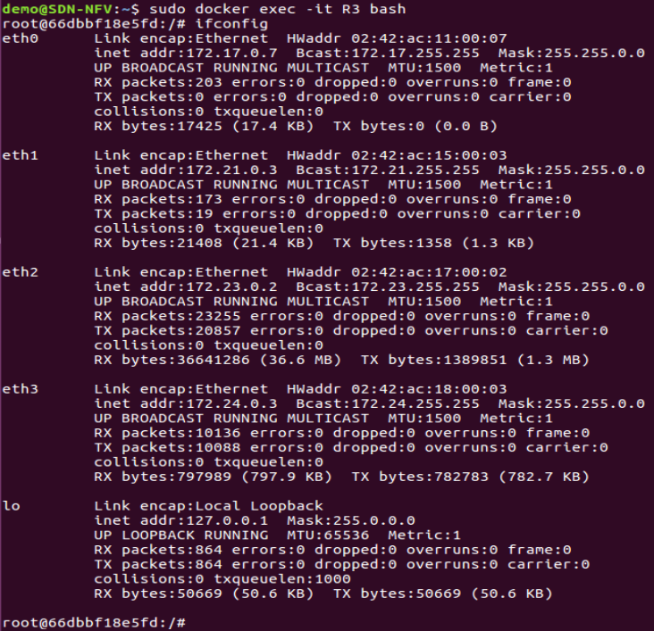

Slide 5
